Slide 1
International Postgraduate Student Orientation
September 2026
Trinity Global Experience Team
Trinity Global

Slide 2

Welcome

Slide 3

Today’s session
International Student Support at Trinity
Events at Global Room
Immigration and visas
Bank Accounts
Working and PPS number
Health Insurance
Safety
Staying connected
Cultural adaptation
Q & A

Slide 4

Irish language ice-breaker
English
Good Morning
What is your name?
Aoife is my name!
A hundred thousand welcomes!
How are you?
I am good
Hello
Thank you
Goodbye
Irish
Maidin mhaith
Cad is ainm duit?
Aoife is ainm dom
Cead mile failte romhat!
Conas atá tu?
Tá mé go maith
Dia Dhuit
Go raibh maith agat
Slán
Pronounced
Modjin wah
Cod iss annim dwit
Eefa is annim dum
Kaed meela fail-cheh row-itt
Cun-us ah-taw too
Taw may guh mot
Dee-ah gwit
Guh rev mah agut
Slawn

Slide 5

Image Slide
Global Room
Student Space and
International Student
Support Hub
Trinity College Dublin, The University of Dublin

Slide 6


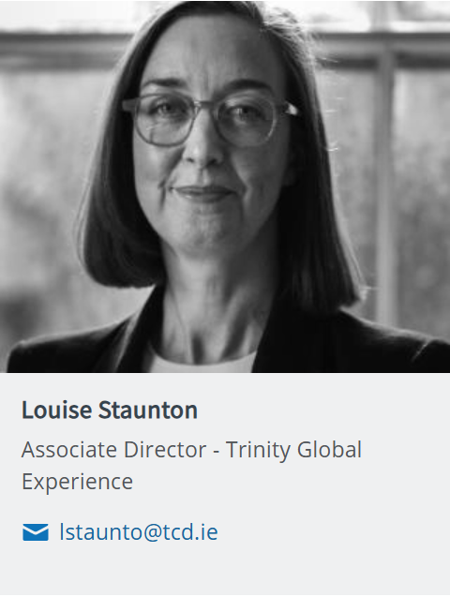
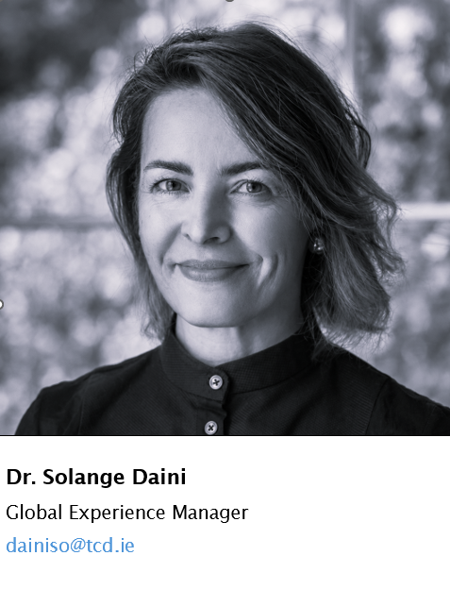
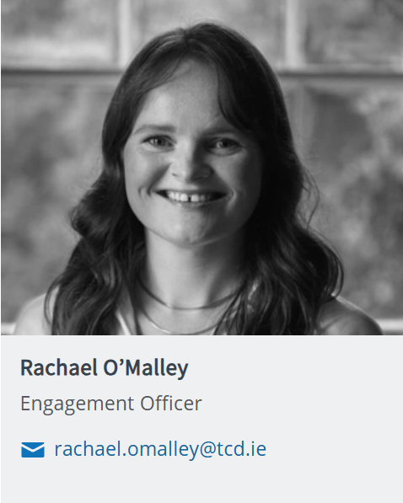
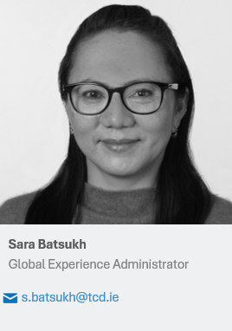
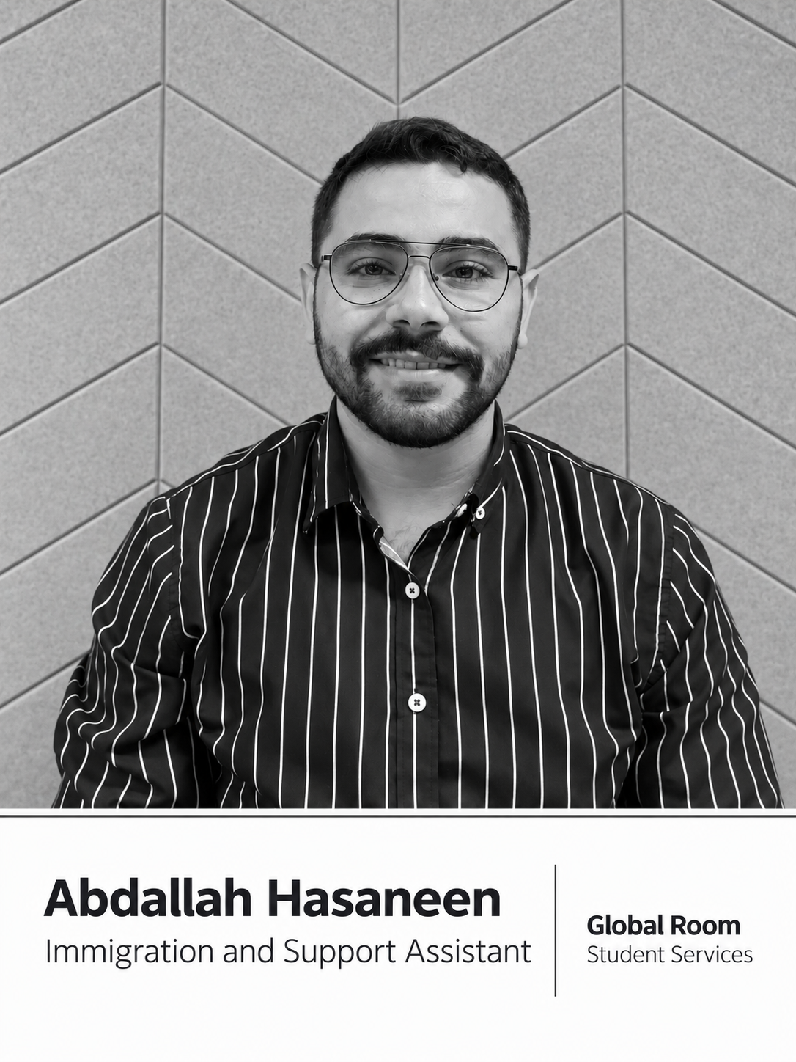
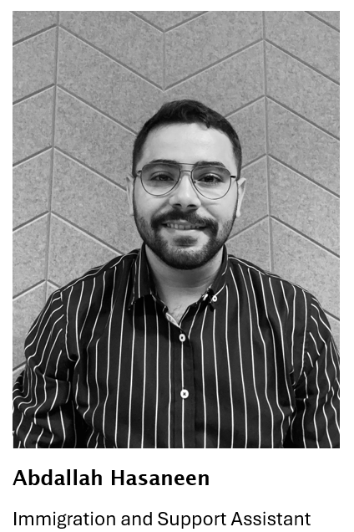
Image Slide
Global Room
Student Space and
International Student
Support Hub
Trinity College Dublin, The University of Dublin

Slide 7


Student Ambassador Team
40+ International and Irish Students
Peer to peer advice to students before and after arrival
Available in Global Room, Monday-Friday, 9am-9pm (in term)​ and online (email or appointment)

Slide 8
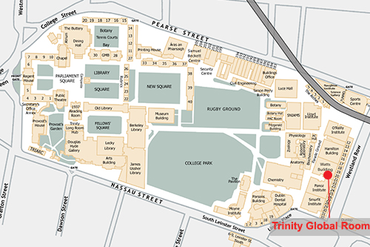
Two Image Slide
Global Room:
Where we are
Location: 1st Floor, Watts Building
(beside Academic Registry)
Open in person –
Monday-Friday, 9am-9pm (in term)
Email: tcdglobalroom@tcd.ie
Drop by or make an appointment with one of our team
OR
Join one of our drop in hours 12-1 this week to speak with the Global Experience Manager or Immigration and Supports Officer.

Slide 9
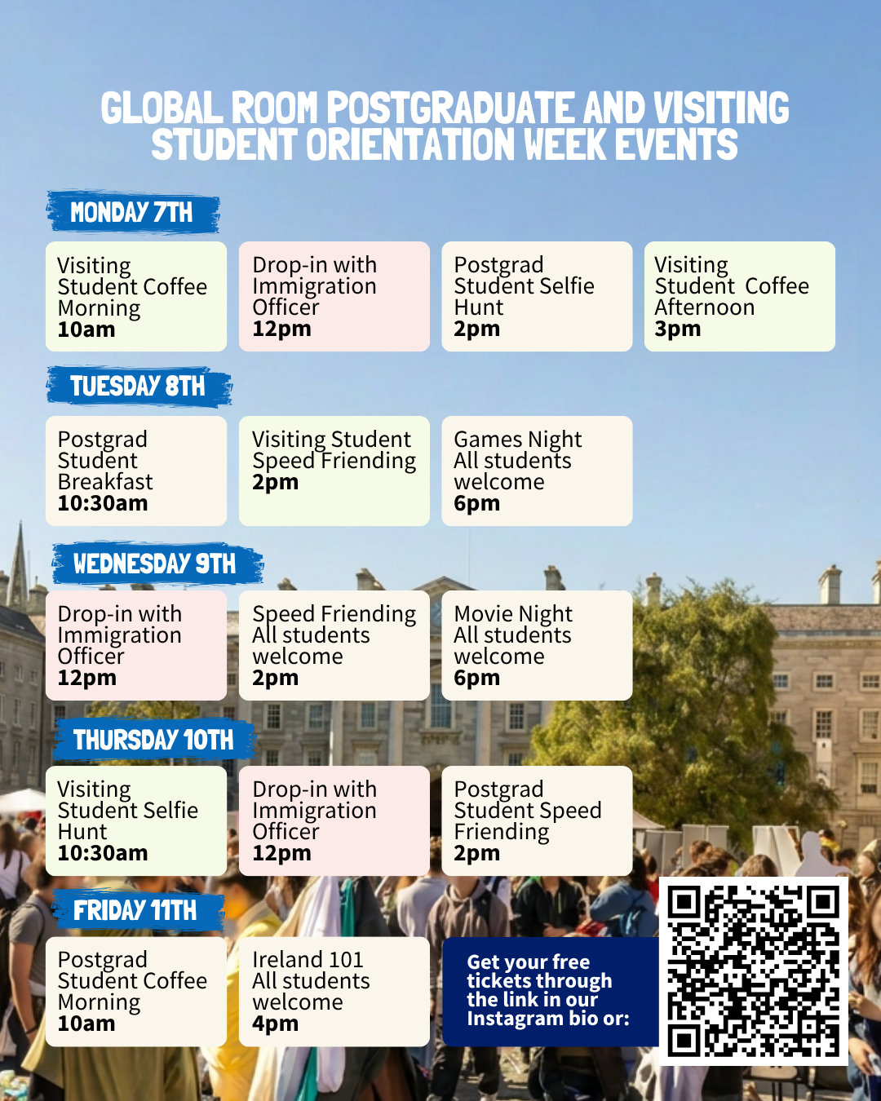
2. Events in Orientation Week for Postgraduate Students
The Global Room has a host of exciting events coming up for the new cohort of postgrad students. It is the most vibrant place for you to meet fellow students from different parts of the world, make new friends, and also feel at home through the various cultural celebrations that we host throughout the year.
From Selfie Hunts, Speed Friending, to Breakfast Mornings, choose your favourite events and register before they are gone!
Follow @tcdglobalroom on Instagram for latest updates.

Slide 10
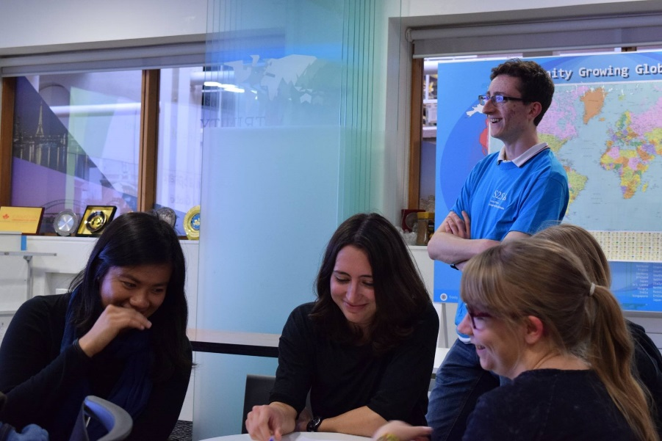
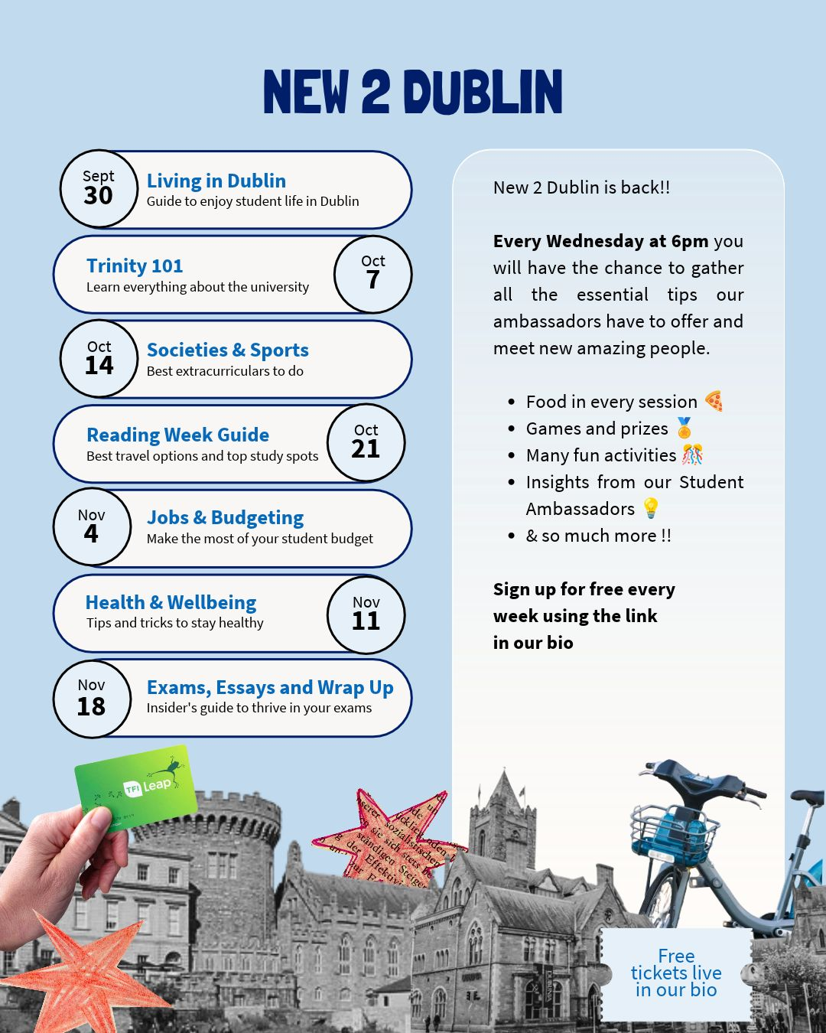
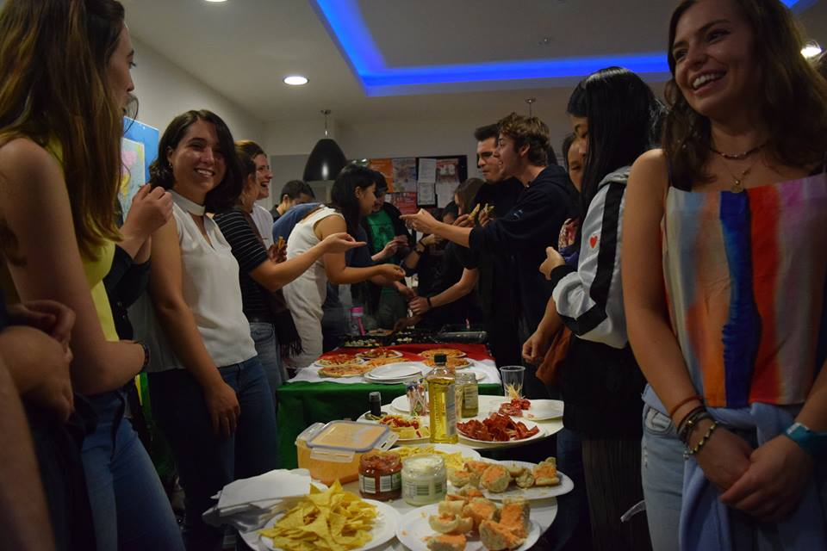
Three Image Slide

Slide 11

3. Immigration
A. Immigration Registration
  Application process & Required documents
  Obtaining appointments
  IRP
  B. Traveling advice
  Schengen Visa
  UK visa
C. Immigration Clinics

Slide 12
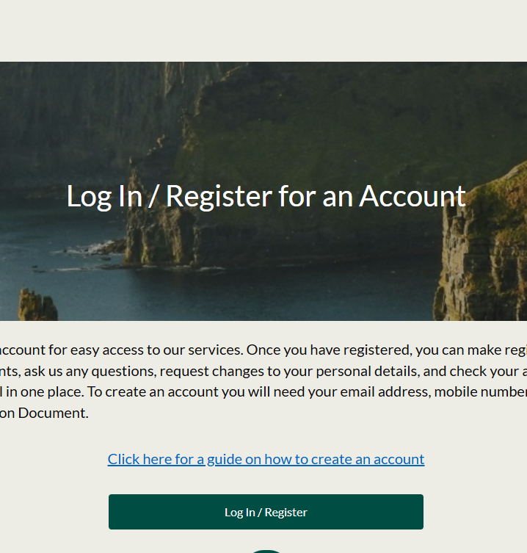
Making an appointment with Immigration Service Delivery (ISD) – for Non-EU students
All non-EU/ EEA / UK students must register with ISD to legally reside in Ireland for study
Register before your entry stamp expires (usually within 90 days of arrival)
If you can't get an appointment in time, don't panic- your permission to remain isn't cancelled
How to Book Your Appointment
Book via the ISD portal: portal.irishimmigration.ie
Appointment location: Burgh Quay Registration Office, 13-14 Burgh Quay, Dublin 2
Arrive 10 minutes early
You'll need: valid email, mobile number (for verification), and your passport to set up the booking

Slide 13

Day of your ISD appointment
Valid Passport
Proof of Registration*
Proof of Fees Paid*
*Proof of registration and proof of fees paid are in the same letter and can be generated and printed from your student portal (my.tcd.ie)
Proof of finances (for non-visa-required nationals only): €10,000 for courses resulting in residence of greater than 8 months; €833 per month or €6,665 (in total) for courses resulting in residence of 8 months or less.
Proof of Health Insurance, policy document is required
€300 Fee (No cash accepted. Credit card or debit card)
https://www.irishimmigration.ie/required-documents/#stamp2
Notes:
There was no link

Slide 14

Proof of Registration Letter
Log on to my.tcd.ie portal
Click on the ‘Registration tab’ for options of letters to print
Click on ‘Confirmation of Registration’
Go to ‘Intray’ on the home tab.
Your letter will be in your ‘New Intray’ or ‘All intray messages’
Click ‘Proof of Registration’ to open and print the file.
Notes:
There was no link

Slide 15
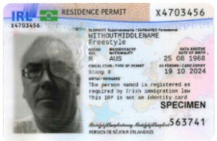
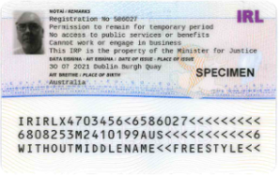
Immigration Card (IRP)
• Called Irish Residence Permit (IRP) card
• Also known as a Stamp 2 (check expiry date, typically December)
• Allow for 15 working days for the issue (by post)
• If not issued in 15 days, submit a query to the ISD
Customer service
* Make sure to confirm the right address at your appointment

Slide 16

Entry visas for other countries
If you are planning to take a trip outside of Ireland:
  Check the visa requirements of the country you are going to
  Ensure you allow sufficient time to apply for your visa,
  Check if there are travel advisories or any restrictions before you travel:
  https://www.dfa.ie/travel/
Notes:
There was no link

Slide 17
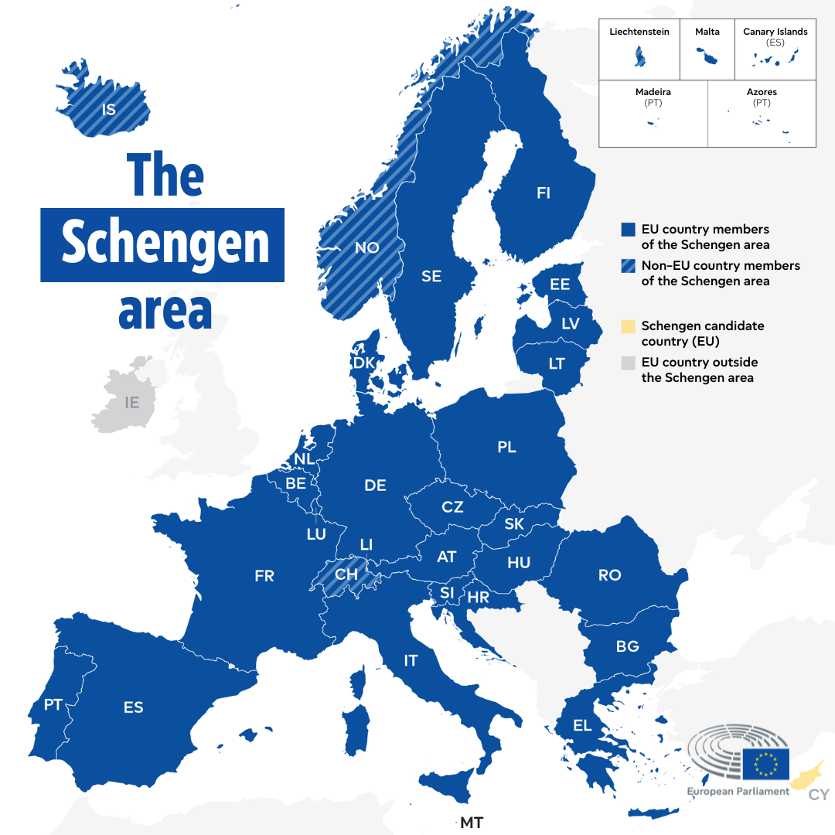
Schengen Visa
  Ireland is NOT part of the Schengen Area
  A Schengen visa allows short-term visits (up to 90days in any 180-day period) to countries within the Schengen Area, which includes most of continental Europe.
  For requirements, check with the Embassy you’re applying to. Documents required include many of those you needed to enter Ireland, as well as your IRP card (you'll get this after your ISD appointment),and Bookings (flights and accommodation).
  Further details - please check the relevant country’s embassy website.
  Book your Schengen visa appointment in advance; it is in high demand!
Notes:
There was no link

Slide 18

UK Visa (incl. Northern Ireland)
Depending on your nationality and the purpose of your visit, you may either need a Visa or an ETA (Electronic Travel Authorisation) to travel to the UK.
More information on what you require and all relevant visa and immigration information: https://www.tcd.ie/study/international/arriving-in-ireland/visa-immigration/
Notes:
There was no link

Slide 19

Global Room Immigration Clinics
  Get answers to your immigration questions
  Tips on getting appointments
  Advice you on any immigration difficulties you may be having
Clinics about first time registration, renewals, third level graduate scheme: In person (Global Room). Details of upcoming drop-in sessions and clinics are advertised on our Instagram account, so keep an eye on our page for dates and information
Email: Immigration and Support Assistant, Abdallah Hasaneen, at tcdglobalroom@tcd.ie to set up meetings or ask any queries.

Slide 20
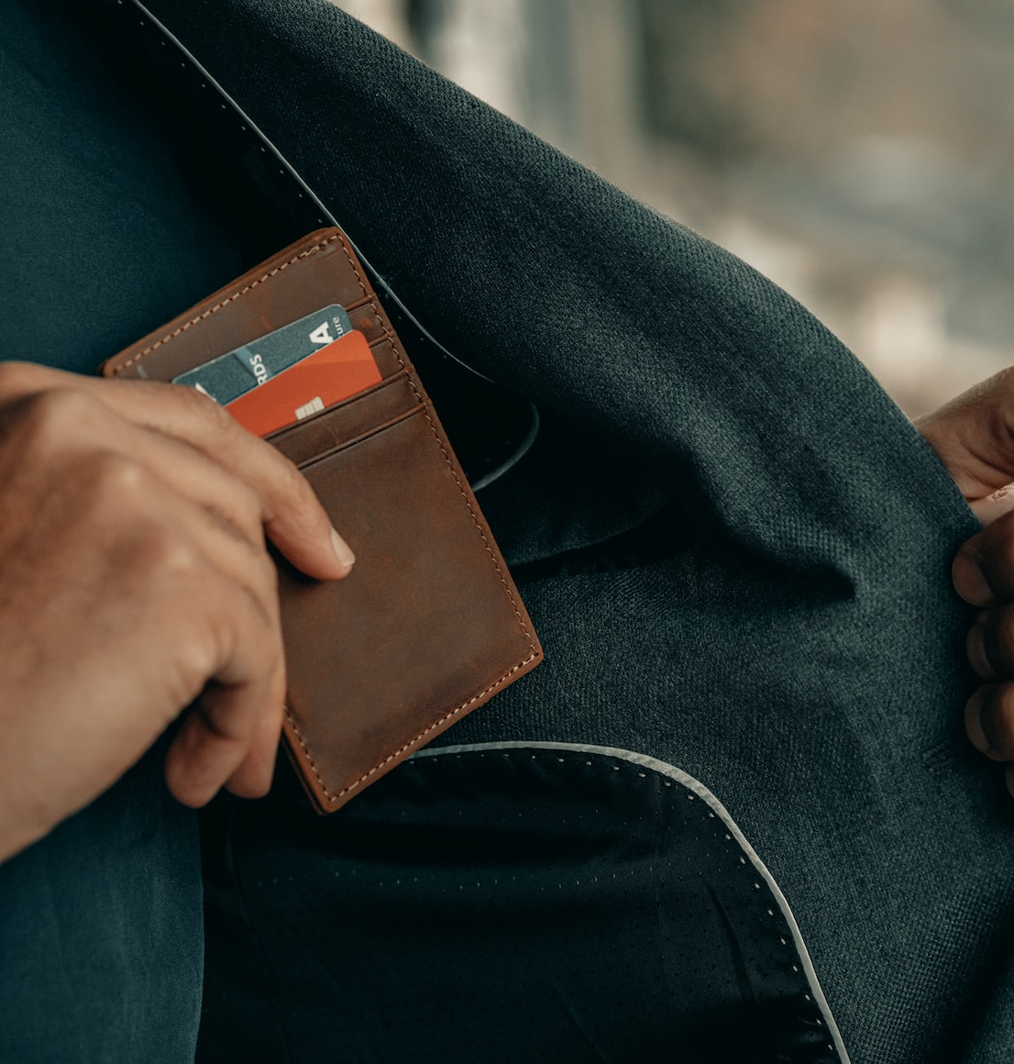
4. Opening a Student Bank Account
  Allied Irish Bank (AIB): www.aib.ie​
  Bank of Ireland (BOI): www.boi.ie
  Revolut: www.revolut.com
  Money Jar: https://moneyjar.world/ (Money Jar - Student Onboarding TCD code 89610) * (Can open before arrival and permanent Ireland address is not required)

Slide 21

Opening Requirements
Documents that may be required to open a bank account​:
Proof of address in Ireland: Letter can be obtained from Academic Registry.
Proof of ID: Passport.
Bank Statement from your home country​
Other documents depending on each bank and students’ nationality

Slide 22

Note
Allow time for your account to become active
When securing private accommodation, most letting agents and landlords will accept cash or bank draft (which you can obtain with a foreign debit card or cash in an Irish bank) for the first month’s rent and security deposit, as long as you set up direct debit from an Irish account as soon as possible after opening your new bank account

Slide 23

5. Working in Ireland
EU passport-holders: Have the same rights to work as Irish citizens
Non-EU Students attending a full degree full-time course with an Irish Residence Permit (IRP) card (Stamp 2) are entitled to take up casual employment
  Non-EU citizens must register with Immigration Service Delivery (ISD) and have their IRP card before commencing employment
  Allowed to work 20 hours during term time, and 40 hours between December 15 - January 15 and June 1 -September 30 only
  The right to work lapses automatically on expiry of immigration permission
  (Keep an eye out for our sessions on the Stamp 1G 'Graduate stay back visa' for after your degree – or check out the prerecorded video on our visa and immigration webpages)

Slide 24
Your PPSN (Personal Public Service Number)
A PPSN (Personal Public Service Number) is a unique reference number in Ireland you need to access social welfare benefits, public services, and for areas like employment, tax, and healthcare.
PPSN applications are made online through MyWelfare.ie.
  First set up a MyGovID account.
  Need: proof of identity, proof of address (your College registration letter); and why you need a PPS. You should add ‘study/education’ on your application (only note ‘employment’ reasons if you have a job offer you can include in your application).
    Study/education evidence: your College registration letter and your Blackboard Timetable.
Attend an in-person appointment at an Intreo Centre (many offices nationwide, two in Dublin city)
If successful, your PPS number will be sent to you by post at your Irish address, usually within 2–4 weeks, but it can vary depending on demand.
More information: https://www.citizensinformation.ie/en/social-welfare/irish-social-welfare-system/personal-public-service-number/

Slide 25

6. Health Insurance
All non-EU students are required to have private medical insurance. This should provide emergency accident cover and should cover any period of hospitalisation.
For your 1st year, can use insurance from your home country.
Where to obtain?
Irish Life: www.irishlifehealth.ie/ (Trinity student group scheme) Scheme Number: 20932 | Scheme Name: Trinity College Dublin Non-EU Students (no wait period; no load for pre-existing conditions)
VHI Healthcare: www.vhi.ie
Laya Healthcare: www.layahealthcare.ie
Study and Protect: www.studyandprotect.com/unilanding.aspx
Notes:
There was a link to zoom I left it out

Slide 26
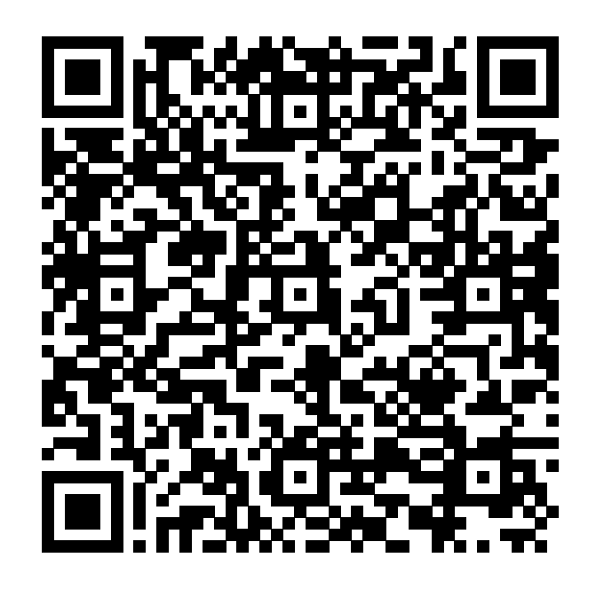

Irish Life Health
Or follow this link: https://www.irishlifehealth.ie/portal/mms/MemberMobilisations/signup/23jjASdoi4lgnHf81SSgqwrihnkn43sdnfkDnskl3K

Slide 27
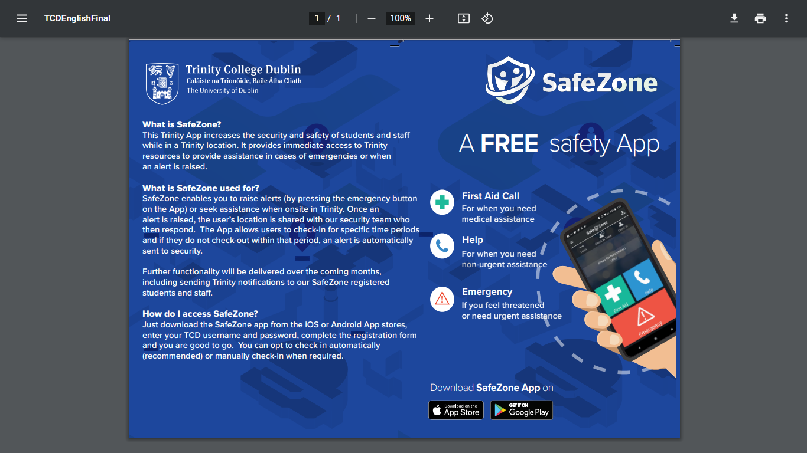
7. Safety

Slide 28

Avoiding scams
Banking Scams/Fraud:
Avoiding financial fraud and scams
Stay informed and alert
If in doubt, consult: www.fraudsmart.ie/
Accommodation/Rental Scams:
Consumer Protection: www.ccpc.ie/consumers/housing/rental-accommodation-scams/
Threshold: https://threshold.ie/faq/how-to-spot-a-scam/
Immigration Scams:
www.irishimmigration.ie/scam-calls-renewed-notification/
www.internationalstudents.ie/info-and-advice/know-your-rights/scams-and-fraud

Slide 29



8. Mobile Phones
SIM Cards from ‘Three’ – free from Global Room
Available for collection Monday-Friday 9-9

Slide 30


9. Crossing cultures
  Cultural adaptation
  Tips on understanding Irish culture, language, slang, humour and accents

Slide 31

“Global dexterity is about learning to adapt your behaviour across cultures – no matter what culture you come from, what culture you are going to, or the situation you find yourself in.”
Andy Molinsky (2013)

Slide 32
Next step… acclimatising to a new culture

Slide 33

Thinking about culture…
What is culture?

Slide 34

Adapting to Irish culture

Slide 35

Similarities and differences
Expectations and first impressions
Cultural differences in:
  Everyday life
  Language and communication styles
  Slang and humour
Differences in academic cultures
Culture shock and homesickness

Slide 36
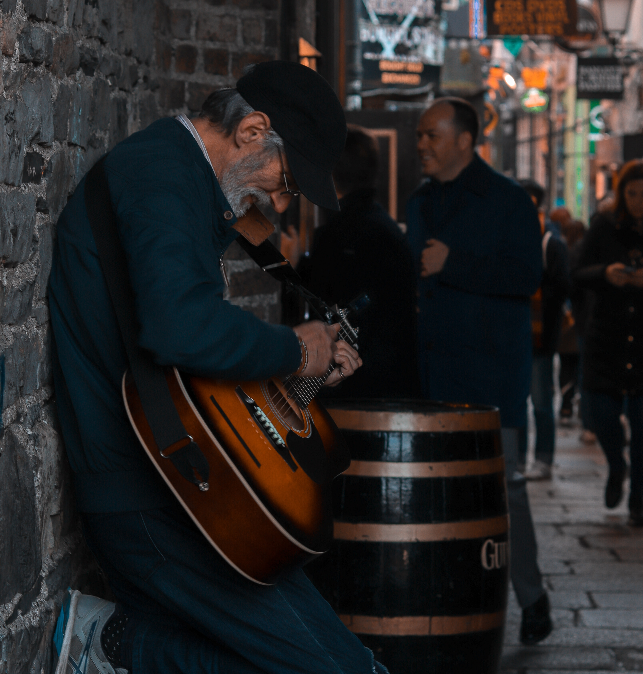
Cultural differences in everyday life
Greetings
Small talk
Punctuality
Socialising and role of the pub in Irish culture
Humour and slagging
Informality even in formal situations
Queuing
Friendliness

Slide 37

Notes:
So perhaps you’re a native English speaker or you have learning English for years and speak it pretty fluently. But maybe now that you’re here in Ireland, you realise that Irish accents are a little different than you were expecting.
Lots of regional accents in Ireland and even within Dublin itself. Takes time to get used to this. Be patient with yourself and ask people to repeat or speak more slowly. Irish people tend to speak fairly fast.
Give a few funny examples – taxi driver
The press = the cupboard
Scoops = drinks
Savage/deadly = brilliant
Trinity – the Pav, the Buttery, the Campanile, Schols

Slide 38

Irish language decoder
An Lár: city centre
An Post: post office
Fir: "men" - often used on bathroom doors
Mná: (pronounced muh nah) "Women" (often used on bathroom doors)
Gardaí - The Guards – the police

Slide 39
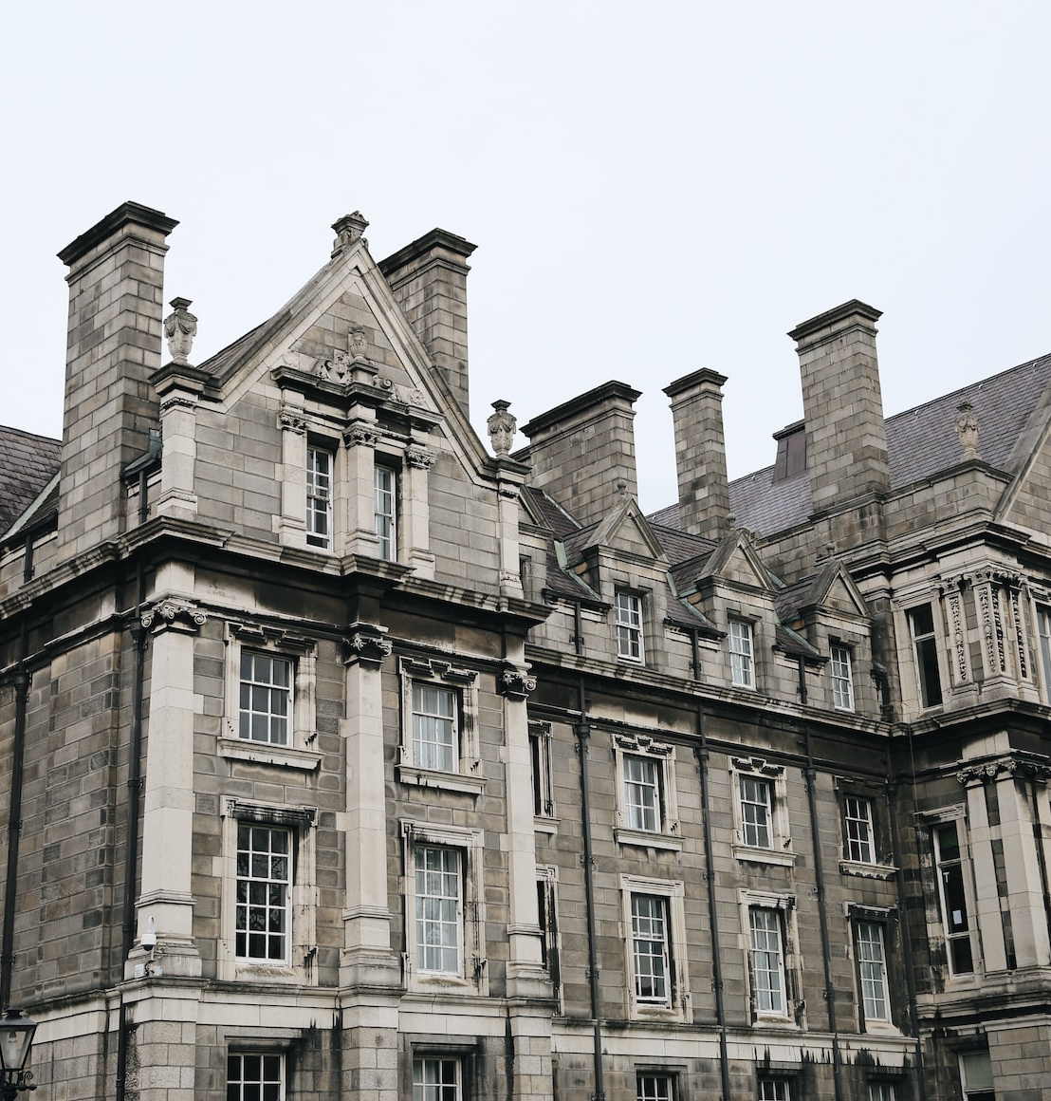
TCD Jargon Buster
Vocab:
“College” – what we call Trinity
Michaelmas and Hilary Terms = 1st and 2nd semester
Classes = Modules
Invigilator – an examination supervisor
Provost – our College President
www.tcd.ie/students/jargon-buster/

Slide 40

Different ways of communicating
Indirect language - The Irish sometimes avoid saying "No" and being direct
Eye contact
Swearing

Slide 41

Don’t forget we speak another language in Ireland…
But we also have many regional accents…

Slide 42

What to do if you are finding accents hard to understand…
  It’s ok to ask people:
  To repeat what they said
  To slow down
  To clarify or explain new words that you are not familiar with
  It takes time to get used to new accents

Slide 43

Culture shock and homesickness
Culture Shock Curve
Different phases of adjustment
  From Honeymoon to "shock" - uncertainty and doubt – to adaptation
Studying internationally pushes your boundaries
Becoming comfortable outside your comfort zone

Slide 44

Coping with change and settling in
Talk to new friends or to Trinity staff
Get into a routine here
Get support from home... but not too much - live in Ireland's time zone, not the one back home
Take care of yourself, eat well and exercise
Take the initiative - Go out and meet Irish people - Join college clubs and societies
Immerse yourself in Irish life - read newspapers, watch Irish TV, social media

Slide 45

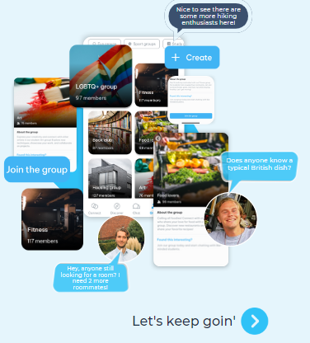
Goin’ to Trinity community app - Join via link
Join and set up groups
Meet your Trinity community
Notes:
There was a different link to zoom I left it out

Slide 46
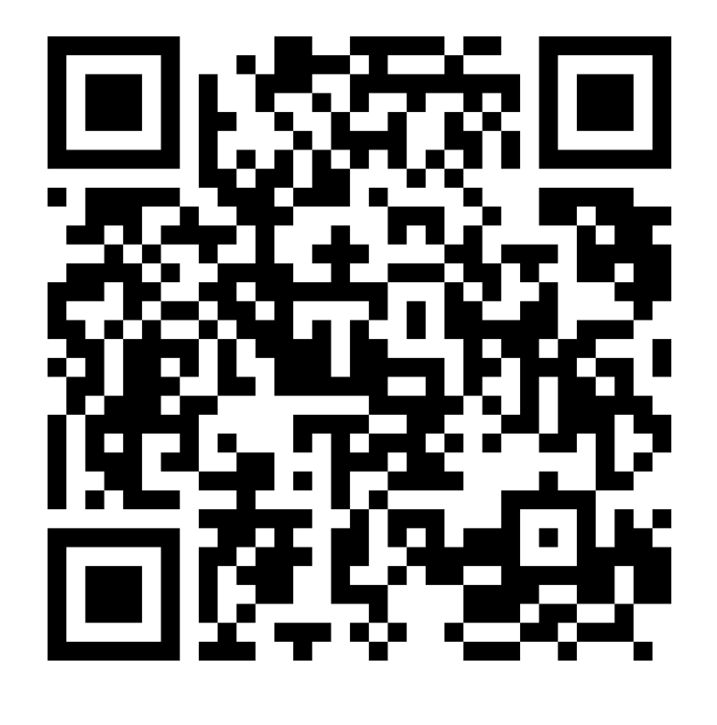
Goin App
Or follow this link: https://register.goinconnect.com/role-selection/94673

Slide 47


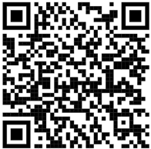
Welcome Guide: www.tcd.ie/study/assets/pdfs/Welcome-To-Trinity-2026.pdf

Slide 48

Be social
@TCDGlobalRoom

Slide 49

Thank You. Any questions – come up to us now – or drop by the Global Room at any point.
Good luck with your studies and have a wonderful time at Trinity.
Email: tcdglobalroom@tcd.ie www.tcd.ie/students/

